Slide 1
VALUE-ADDED BUNDLES
THE LOT POLISH AIRLINES’ NEW FARES IN ECONOMY CLASS

Slide 2
NEW FARES IN ECONOMY CLASS
The LOT Polish Airlines are introducing new fares in Economy Class – The Value Added Bundles (VAB) - allowing for better adjustment to the clients’ needs
The changes allow choice between greater amount of ancillary services in the price of the ticket and greater flexibility in case of changing travel plans
In the available booking class there will be a choice of three types of tariffs at the same time, depending on the preference of the passenger. Each of these tariffs, regardles of the booking class, will always contain the same services and tariff conditions
„Saver” - For people, who first of all seek low price and travel without large baggage
„Standard” - Classic LOT offer for those travelling to their destination for longer stays
„Flex” - Offer for those, whose plans may change partially (different dates) or completely (cancellation)
For customers, wishing to take advantage of the higher standard of travel and the benefit of ancillary services, fares in both Premium Economy and Business Class are available
LOT tailored to your needs
VALUE ADDED BUNDLES

Slide 3
WHY ARE THEY BEING IMPLEMENTED?
MARKET
CUSTOMER AND COMPANY IMAGE
EFFICIENCY
Current fare structure does not allow for effective competing with low-cost carriers (coverage of LOT’s offer in 37% in 2015)
Low-cost carriers are constantly improving the quality of their services. Flying onboard of their aircrafts stops being a shameful compromise
LOT functions in a dynamic market. Major legacy carriers have already unbundled their offer.
Current fare families are outdated, unclear and do not meet the needs of contemporary user of an airline
People become more aware of their customer behaviour and their buying preferences – new fare families allow for informed configuration of the service (the customer chooses what he wishes to pay for)
Simplification of the customer journey helps attracting new users of the air transport as well as the current clients of low-cost carriers
VAB provide better segmentation of the clients and optimisation of their utility function
Reaserch shows positive reception among the customers – LOT reaches out and meets customers’ expectations
New fare families increase capability of upselling LOT’s offer – additional revenue stream
Improvement of the offer’s legibility and introduction of grading of services permits better use of client’s price elasticity
Well-implemented VAB mean increased fare revenue
VAB allow for a more dynamic development of the e-commerce distribution channel
VALUE ADDED BUNDLES

Slide 4
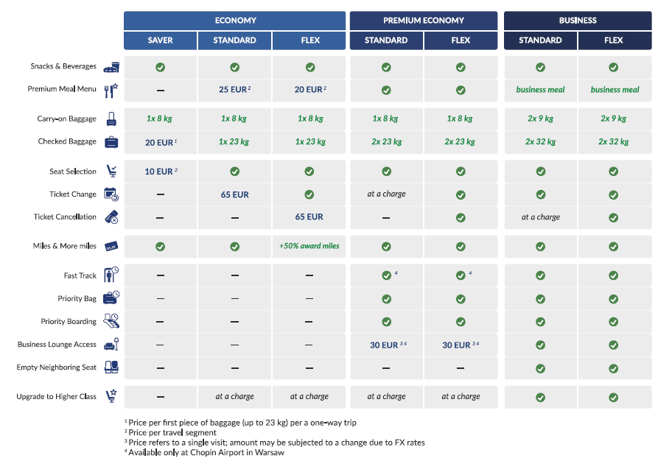
NEW FARES INTRODUCE NEW SERVICE BUNDLES IN THE ECONOMY CLASS…
VALUE-ADDED BUNDLES
3 product bundles will be available in the LOT Economy Class: - „Saver” – for people, who first of all seek low price and travel without large baggage - „Standard” – classic LOT offer for those travelling to their final destination for longer stays - „Flex” – offer for those, whose plans may change partially (different dates) or completely (cancellation)
Possibility of purchasing chargeable ancillary services, enriching each bundle
Communication of the new travel options in Economy Class will create platform for communication of the benefits in the Premium Economy Class and Business Class
VALUE ADDED BUNDLES

Slide 5
…AND ORGANISE ENTIRETY OF LOT’S OFFER TO THE CUSTOMER
THE OFFER IN PREMIUM ECONOMY AND BUSINESS CLASS REMAINS UNCHANGED
VALUE-ADDED BUNDLES
VALUE ADDED BUNDLES

Slide 6
RECOGNITION OF THE KEY NEEDS OF THE GROUPS OF CLIENTS WAS KEY IN CREATION OF THE NEW FARES
24%
22%
22%
13%
6%
14%
Pragmatic Commuters
Middle-Class Tourists
Spontaneous Travellers
Circumstantial Visitors
Corporate Travellers
Occasional Business Flyer
Travel frequently for economic purposes
Their default brand is Ryanair
Sensitive to price, they are not willing to pay for ancillary services, despite the desire of experiencing them
Bred by cheap airlines: accepting inconveniences
They feel accustomed to flying, having had some experience in it
Travel mainly for touristic purposes
More often than other segments, they travel to distant, exotic destinations
Usually travel with the family
Segment, which is most open to the legacy carriers
Least focused on the price
They are accustomed/experienced in flying; seek quality and comfort
Travel mainly for touristic purposes
Very flexible and are able to adjust the travel dates to the ticket price
Can spontaneously decide to fly to certain places, simply influenced by good offer
Fly predominantly with cheap airlines, frequently Wizzair
Flying does not cause stress to them, it is a part of their lifestyle, way of seeing the world
They manifest aspirations to travel in higher standard
Travel primarily to visit the family
Most frequently of all segments, the third party is responsible for the purchase of the ticket
To the greatest extent guided by price, when choosing flights
Possibility of a direct flight is important to them
They have no experience in flying and travelling on an airplane is very stressful to them
Fly for business purposes relatively frequently
The only segment, for which the main type of airline is a legacy carrier
Rarely decide themselves about the choice of flight
They are not guided by low price, rather have ancillary services included in the price
They have experience in travelling on an airplane, hence usually travelling only with carry-on baggage
Travel for business purposes rather seldomly
Usually decide about the choice of flight themselves and often travel alone
Frequently use cheap airlines (1/3rd considers such carriers)
Ryanair is their top-of-mind brand and it is used by them most often
When choosing, they are heavily guided by price and it is more important than potential ancillary services

Slide 7
ECONOMY SAVER
If you are looking for low prices and going on a trip, where carry-on baggage is enough – this is an offer for you
Free services
Snack & beverage
Points in the Miles & More program
8kg carry-on baggage
Fare conditions
Change of reservation: not permitted
Ticket refund: not permitted
Chargeable ancillary services
23kg checked baggage
Seat selection
VALUE ADDED BUNDLES

Slide 8
ECONOMY STANDARD
Classic LOT offer for Economy Class, in line with the principle : „Quality at a good price”
Free services
Snack & beverage
Points in the Miles & More program
8kg carry-on baggage
23kg checked baggage
Seat selection
Fare conditions
Change of reservation: at extra charge
Ticket refund: not permitted
Chargeable ancillary services
Premium Menu meal
Upgrade to higher compartment
VALUE ADDED BUNDLES

Slide 9
ECONOMY FLEX
Enjoy the comfort, even if your travel plans may be subject to change
Free services
Snack & beverage
Points in the Miles & More program
8kg carry-on baggage
23kg checked baggage
Seat selection
50% award points in the Miles & More program
Fare conditions
Change of reservation: free of charge
Ticket refund: at extra charge
Chargeable ancillary services
Premium Menu meal
Upgrade to higher compartment
VALUE ADDED BUNDLES

Slide 10
NEW FARES COMPLEMENT LOT’S OFFER, ALLOWING CLIENTS TO ADJUST THE BEST OFFER TO THEIR PERSONAL NEEDS
For whom?
Economy Class
Premium Economy
Business Class
Saver
Standard
Flex
Standard
Flex
Standard
Flex
For those, who first of all seek low price and use exclusively carry-on baggage
For those choosing the existing LOT Economy Class with the possibility of purchasing ancillary services
For those requiring greater flexibility in the event their travel plans are subject to change
For those seeking higher standard of travel with ancillary services shortening the time spent at the airport
For those expecting Premium Economy standard with the possibility of free change of reservation or ticket refund
For those travelling in the highest standard with rich bundle of ancillary services and free change of reservation
For those needing complete flexibility in Business Class
VALUE ADDED BUNDLES

Slide 11
NEW FARES COMPLEMENT LOT’S OFFER, ALLOWING CLIENTS TO ADJUST THE BEST OFFER TO THEIR PERSONAL NEEDS
For whom?
Economy Class
Premium Economy
Business Class
Saver
Standard
Flex
Standard
Flex
Standard
Flex
For those, who first of all seek low price and use exclusively carry-on baggage
For those choosing the existing LOT Economy Class with the possibility of purchasing ancillary services
For those requiring greater flexibility in the event their travel plans are subject to change
For those seeking higher standard of travel with ancillary services shortening the time spent at the airport
For those expecting Premium Economy standard with the possibility of free change of reservation or ticket refund
For those travelling in the highest standard with rich bundle of ancillary services and free change of reservation
For those needing complete flexibility in Business Class
VALUE ADDED BUNDLES

Slide 12
NEW FARES COMPLEMENT LOT’S OFFER, ALLOWING CLIENTS TO ADJUST THE BEST OFFER TO THEIR PERSONAL NEEDS
For whom?
Economy Class
Premium Economy
Business Class
Saver
Standard
Flex
Standard
Flex
Standard
Flex
For those, who first of all seek low price and use exclusively carry-on baggage
For those choosing the existing LOT Economy Class with the possibility of purchasing ancillary services
For those requiring greater flexibility in the event their travel plans are subject to change
For those seeking higher standard of travel with ancillary services shortening the time spent at the airport
For those expecting Premium Economy standard with the possibility of free change of reservation or ticket refund
For those travelling in the highest standard with rich bundle of ancillary services and free change of reservation
For those needing complete flexibility in Business Class
VALUE ADDED BUNDLES

Slide 13
CONSTRUCTION OF THE NEW FARES IS BASED ON THE THEORY OF PRICE ELASTICITY – VARYING FOR DIFFERENT SEGMENTS OF CLIENTS
Benefits of the new offer:
Better adjustment to the preferences of different clients – choice of 3 options for each booking class
Plain distinction between benefits resulting from the standard of travel and fare conditions (rebooking / refund)
Clear, constant price increase between bundles for each O&D
Possibilty of purchasing semi-flex ticket in the lowest booking classes
Within the „standard” in the lowest classes with prices comparable to the present ones, the clients additionally get the possibility of seat selection free-of-charge
VALUE ADDED BUNDLES

Slide 14
NEW FARES IN PRACTICE
New fares will be available for purchase from February 28th 2017 and will cover journeys, commencing on March 1st 2017.
New concept applies to all fares in Economy Class for domestic/short-haul/Middle-East flights* from March 1st 2017. Long-haul flights remain unchanged. New fares concept does not apply to the connecting flights to/from long-haul journeys with the intercontinental through fare.
When purchasing the ticket, the customer can choose between three fares in Economy Class (Saver, Standard, Flex), two in Premium Economy Class (Standard, Flex) and two in Business Class (Standard, Flex). The fares differ in terms of flexibility and in the services included in the price. Additionally, certain services can be added on for a fee.
New fares will be uploaded and correctly displayed in all GDS systems.
For all travels already commenced and based on the old fare structure, old fare conditions will apply. For all tickets issued, basing on the old fare package and not used, upgrade to a higher fare bundle will be possible.
New fares structure does not require changes in existing travel agency contracts.
Changes apply only to the Economy Class.
*VAB will not be implemented on TSE
VALUE ADDED BUNDLES

Slide 15
NEW FARES IN PRACTICE
The new price concept includes very affordable flexible tickets. If the S-Class is available on a flight, for example, the passenger is able to purchase a very affordable flexible ticket with the 'Flex' fare and enjoy significant savings over the former fare concept (flexibility only available starting with the B-class). On the other hand, the passenger could theoretically opt for a 'Saver' fare on a flight on which only the Y-class is still available – and would then have purchased an expensive ticket which could neither be rebooked nor refunded. The price of the ticket therefore, does not determine its flexibility anymore.
New fares cannot be combined with the fares for long-haul flights.
On codeshare flights only Standard and Flex bundles will be available.
The unpublished fares will remain unchanged.
Groups remain subject to group fares. No changes to the current rules.
Benefits for status members will remain unchanged. That means that the status members will have additional luggage in Saver.
In the new Economy fare structure concept after the purchase paying a fee to upgrade from one bundle to another is not permitted, for example, the upgrade from Economy Saver to Economy Standard)
In the new Economy fare structure concept there are no refunds for unused services in a fare, for example, If client book the Economy Standard fare but travel without checked baggage, he will not get a refund for the nonchecked- in baggage).
VALUE ADDED BUNDLES

Slide 16
NEW FARES IN PRACTICE
The first piece of checked baggage can only be purchased in combination with the Economy Saver fare. This piece of baggage will cost less than an additional piece of checked baggage (excess baggage). This service will not be available at check-in.
With the implementation of the new fares, no changes will be introduced to the Kolekcjoner, Partnerzy and Lot dla Firm.
Additional information are included in the training materials, attached to the presentation.
General rules for calculation of tariffs, ticketing and definitions of tariff’s notes will remain unchanged. This also applies to the rules applicable to the changes in the date of flight.
VALUE ADDED BUNDLES

Slide 17
SUMMARY
What?
Vaule-Added Bundles (VAB) are the new fare classes introducing plain and clear service range, the passenger pays for. They allow for better segmentation of the clients, through the possibility of adjusting services to their individual needs.
With VAB the customer will be able to choose one of 3 fare options in each booking class:
Saver – basic and cheapest offer without checked baggage, for people who first of all seek low price and travel without large luggage
Standard – classic LOT offer for those with longer stay at the destination, enriched with the seat selection and ancillary services at extra charge
Flex – offer for those, whose plans may be subject to change
Where?
Implementation of VAB covers Economy Class on DOM, SH i ME flights, available in all distribution channels.
How?
VAB will be available in all distribution channels.
When?
New offer will be introduced on 28.02.17 (commencement of sales) and will cover journeys commencing on 01.03.17
VALUE ADDED BUNDLES

Slide 18
VALUE ADDED BUNDLES

Slide 19
VALUE ADDED BUNDLES

Slide 21
THANK YOU

